Slide 1

Experience Driven
Management
with Aruba Central
Simon Wilson
Aruba CTO, UK & Ireland

Slide 2


IT CHALLENGES
MORE DEVICES, APPS, AND SERVICES
7.6B
Enterprise IoT
Devices by 2020
EVOLVING SECURITY CHALLENGES
80%
Using Valid Credentials
LIMITED RESOURCES
AND EXPERTISE
0-2%
Growth
in Budgets

Slide 3

By 2021, 40% of IT staff will hold multiple roles, most of which will be business- rather than technology-related.
Gartner 2018 Predictions
THE ROLE OF IT IS SHIFTING
Old World
New World
Network
Management
Experience Management
Element
Monitoring
Services-Oriented IT
Automation /
Orchestration
Cloud
Break/Fix Tools
Notes:
The Role of IT is Shifting –
IT Specialists currently represent about 42% of the entire IT workforce. However, analysts predict increasing digital business initiatives to drive a complete transformation of skill sets. Starting with Infrastructure and Operations (I&O), IT will see an increase in non-technical managers and an evolution to ‘versatilists’, driving the need for more intelligence in solutions and a shift from break/fix and element monitoring, to automated solutions ensuring the availability and quality of the user experience.

Slide 4



SCALABLE & COMPREHENSIVE
IT MANAGEMENT
Simplified onboarding of new customers, sites & locations
Workflow-based logic helps ensure service availability & performance
Create and expand
revenue opportunities with differentiated services

Slide 5

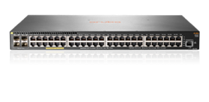
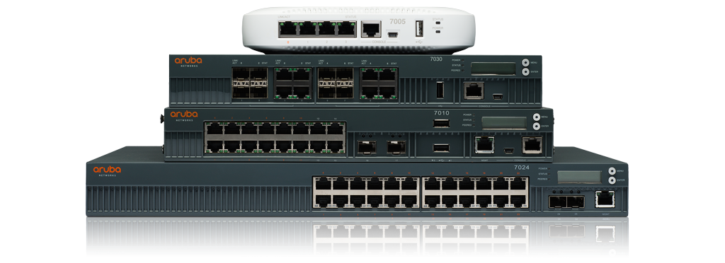

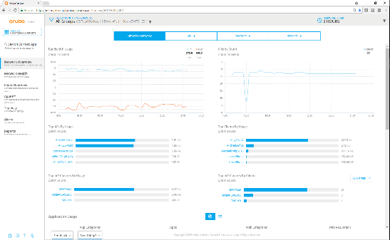




ARUBA CENTRAL CLOUD
MANAGEMENT
Wired and Wireless
Experience Driven Management
    Redundant & Frequently Updated Scalable Architecture
Aruba-OS
Switches
Branch
Gateways
Instant
Access Points
    Streamlined Provisioning & Workflow-Driven Usage Models
Value Added Services
Guest
Wi-Fi
Presence
Analytics
Connectivity
Health
    Built-In API Extensibility and Managed Services Mode
  Extensibility via REST APIs
  (Configuration, Monitoring, Alerts and Secure Access)
Notes:
Introducing Aruba Central –
Now its time to introduce Aruba Central, our experience-driven, cloud management solution for branch wired and wireless infrastructures.
Aruba Central empowers administrators through scalable planning and deployment, integrated assurance and value added services to ensure the availability, performance and security of infrastructure, applications and services. The content that follows highlights Aruba Central’s value in each of these areas.

Slide 6

Planning & Deployment
Provisioning, Assessment and Visibility
Notes:
This section outlines the Planning & Deployment features of Aruba Central

Slide 7


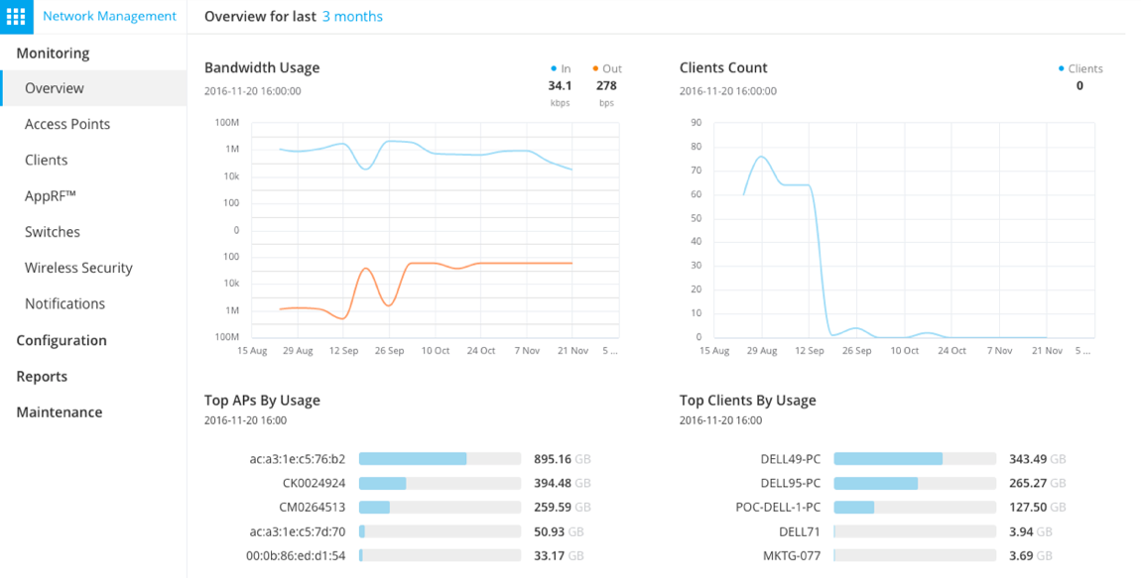
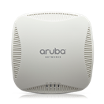
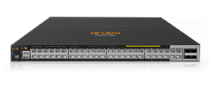
ZERO TOUCH PROVISIONING
    Streamlined Deployment
    No Onsite Expertise
2
3
  Secure (https) account access via Aruba Central
  Configuration sent to Instant AP or Switch
    Installer APP
1
4
    Business Grade Wi-Fi
  Plug in Instant
  AP or Switch
  Network configured
  & operational
Notes:
Zero-Touch Provisioning –
Although deployment isn’t done often, the goal is to simplify the process. Zero Touch Provisioning allows Aruba Instant APs and Switches to be shipped directly to remote sites where ANY person can simply unpack and power up. Once powered, the AP or Switch downloads it’s configuration from Aruba Central and is operational in minutes.

Slide 8
Integrated Assurance
Performance, Analytics and Security
Notes:
This section outlines the Service Assurance features of Aruba Central

Slide 9
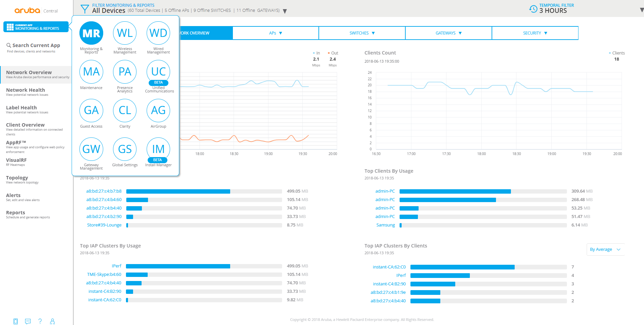
WIRED & WIRELESS VISIBILITY AND CONTROL
    Comprehensive Views Into Key Areas
    Global Filtering to Set Scope
Maintenance for Upgrades, Auditing & Troubleshooting
Role-based Administrative and Managed Services Modes
Notes:
Wired & Wireless Visibility and Control –
Comprehensive management is provided, through applets covering Monitoring & Reporting, Wired & Wireless, Presence & Connectivity Analytics, Guest Access and Maintenance. Context settings for the entire interface are available by global group and time based filters.

Slide 10
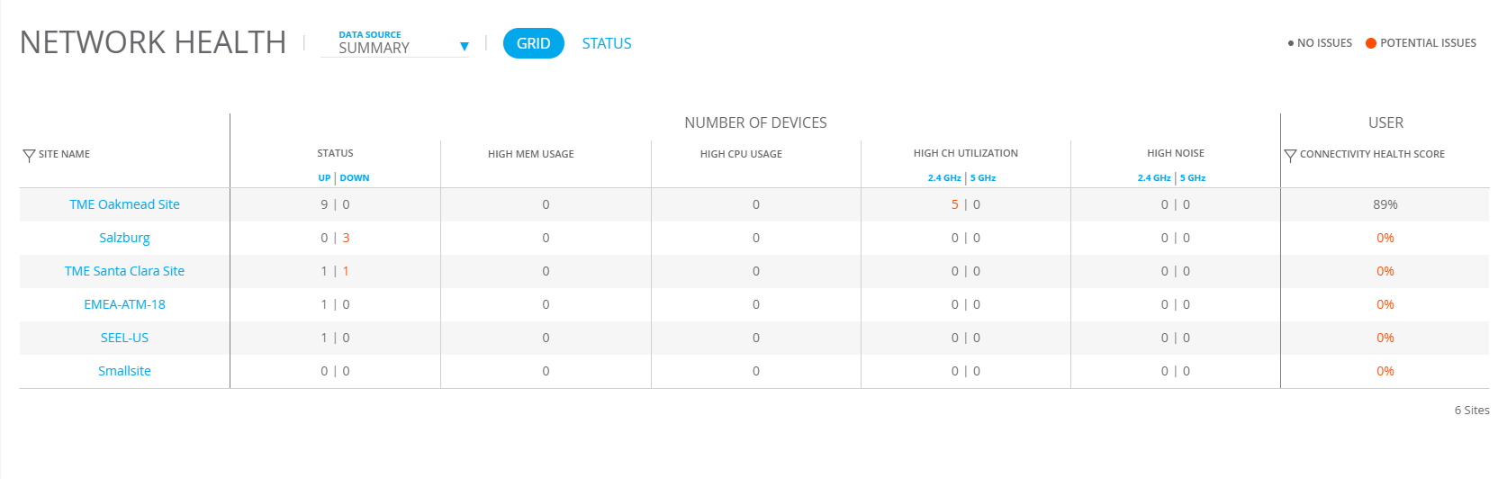
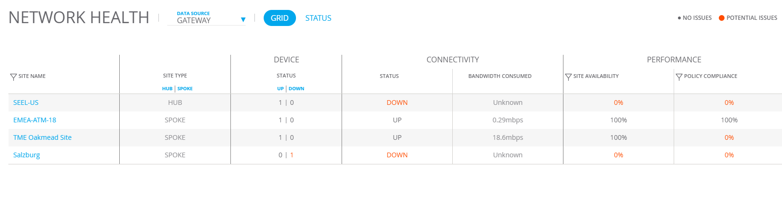
NETWORK HEALTH MONITORING
SITE/LOCATION HEALTH DASHBOARD
    Broad visibility of Key Performance Indicators across networks
    Quickly identify interference sources and rogue devices
    View via dashboard, reports or API’s
Notes:
Location Based Site Health Monitoring -

Slide 11
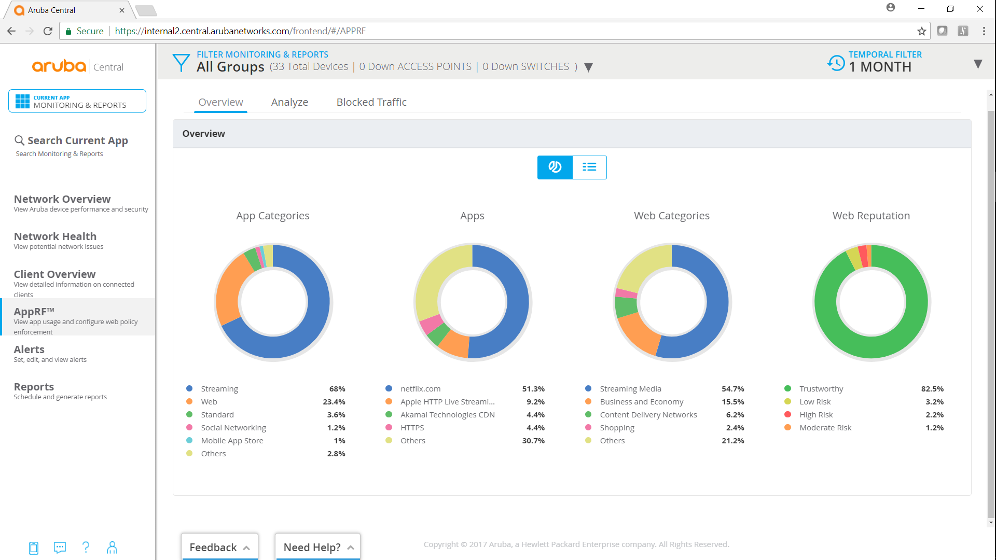
APPLICATION & WEB CONTENT FILTERING
APPLICATION HEALTH
    Monitor usage to optimize and secure the network
    Prioritize business critical applications
    Block inappropriate content by website or catagory
    Enforce on a per user, device or location basis
Notes:
AppRF intelligently monitors application usage and web traffic to secure and optimize the network. Deep Packet Inspection monitors usage and performance while optimizing bandwidth, priority and network paths in real time –even for applications that are encrypted or appear as web traffic. Application RF provides visibility into over 1800 applications including applications such as Box, Skype, SalesForce.com and share point.
Application RF also provides web content filtering enabling IT to control what users can browse on the internet. App. RF redirects web URLs to a cloud database that contains up to date content and reputation information of millions of web pages. This information can be used to determine what type of application and web browsing are allowed on the network at what time of day. For example you can allow Netflix traffic after hours. The application RF Cloud database is updated in real-time with malicious web addresses so you can catch new types of web attack before they can cause damages. Clients can be configured to use APP RF web filtering even when they are not on an Aruba network which keeps client safe no matter where they are. Web content filtering protects the network against viruses and malware gives IT control over which web sites users can access.

Slide 12
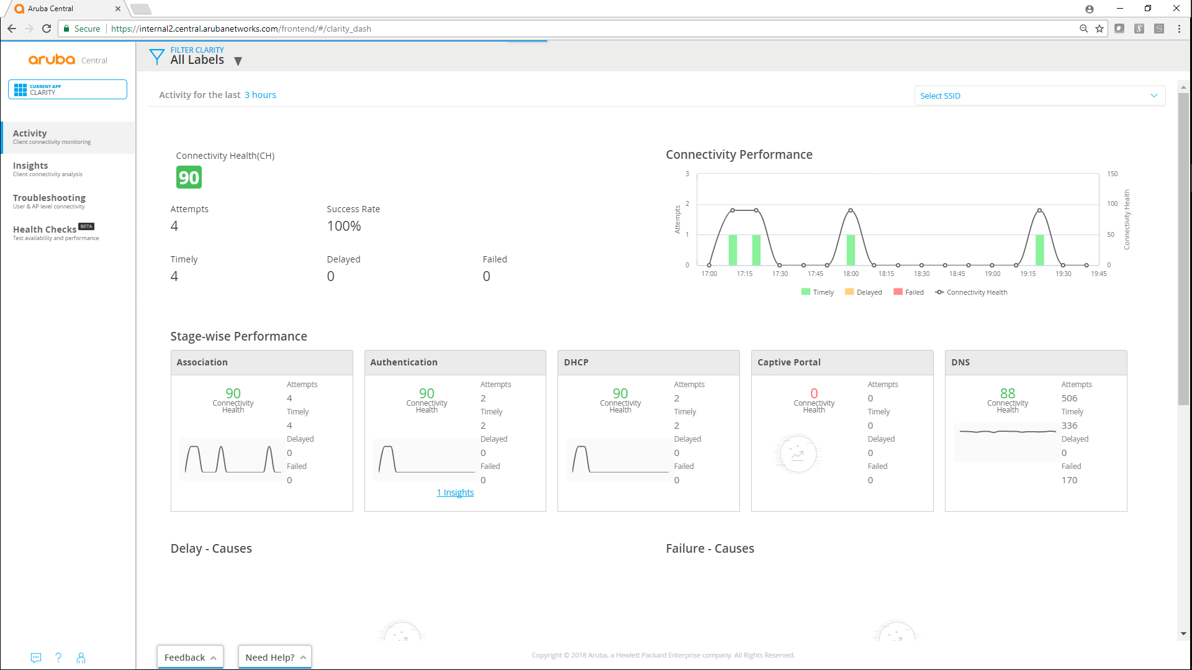
STAGE-BASED CONNECTIVITY HEALTH
    User monitoring across authentication, DHCP and DNS
    Isolate root cause and impact of delays or failures
    Event auditing by device or client

Slide 13

GUEST WI-FI ACCESS & EXPERIENCE
    Custom landing page, including logos, colors and banner ads
    Anonymous, self registered, social and sponsor created logins
    Control Usage, including initial landing page, duration & networks
Notes:
Custom captive portals – logo, background, color, ads
Registration choices – anonymous, self-registration, social login, Facebook Wi-Fi
Control options – duration, usage, landing page

Slide 14
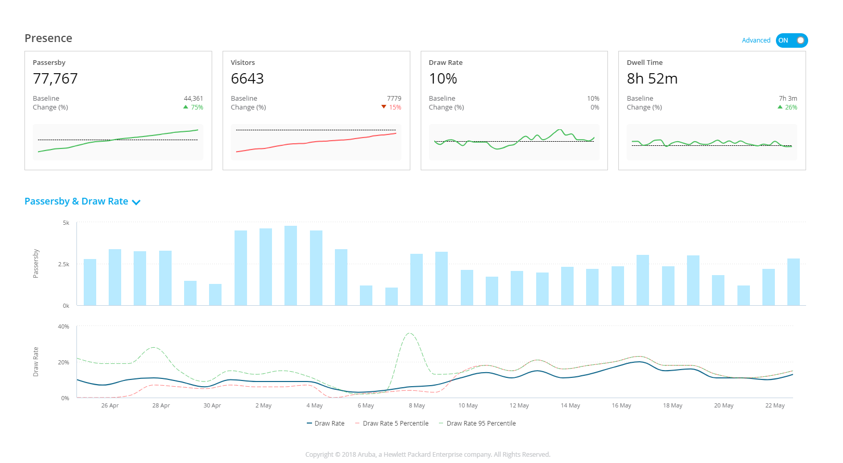




SITE BASED PRESENCE ANALYTICS
    Increase Traffic – Test displays & signage and measure campaigns
    Improve Engagement – Assess layouts and optimize staffing
    Compare - Metrics across sites
    for baselining and performance
Passerby
Entered
Engaged
Notes:
Customer traffic & engagement based on presence & RSSI
Customizable conversion metrics
Insight across stores & times
No device connection required!

Slide 15
Maintenance & Extensibility
Compliance, API’S and Multi-Tenant Management
Notes:
This section outlines the Expanded Services features of Aruba Central

Slide 16
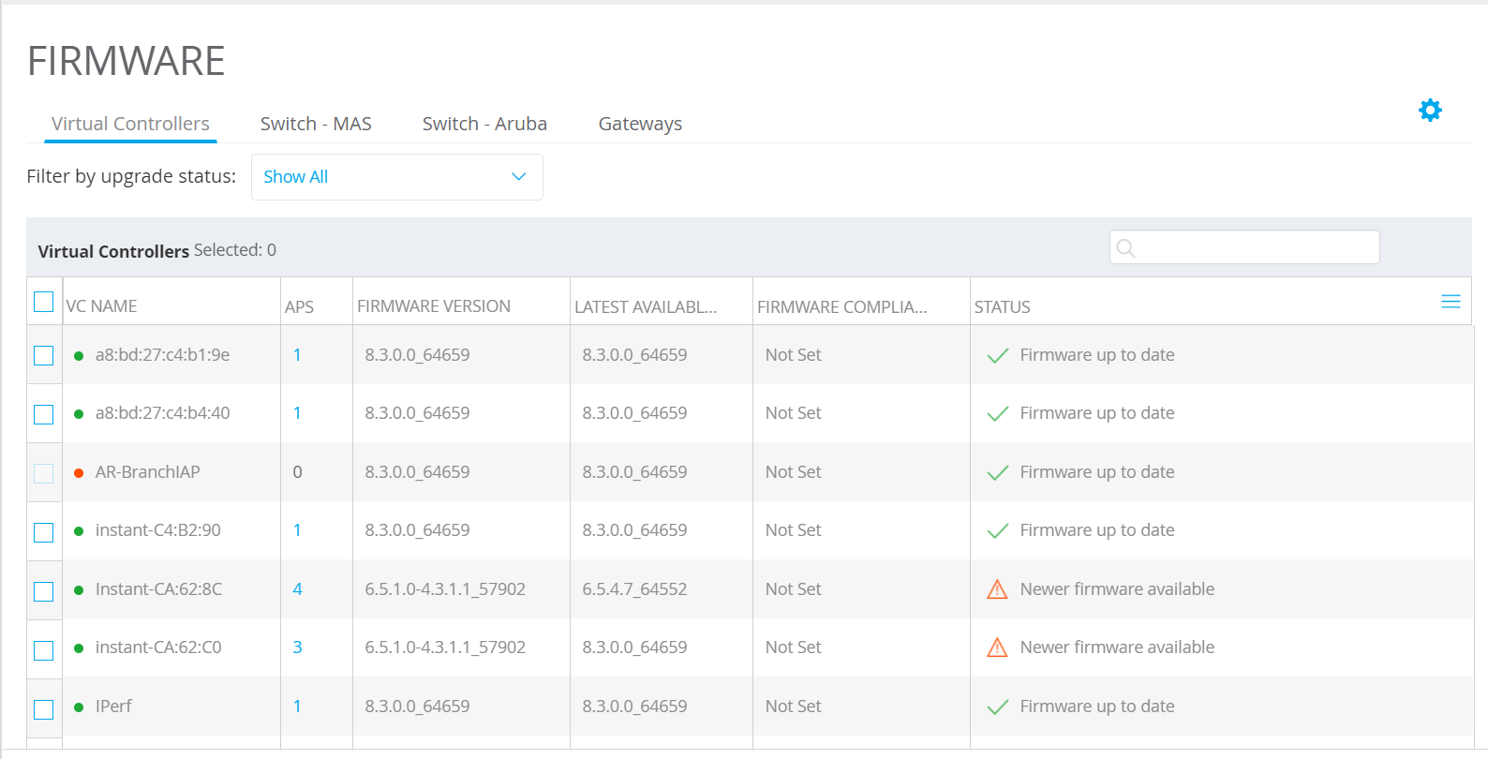
FIRMWARE UPGRADES & COMPLIANCE
    Manage Compliance Status Across Entire Infrastructure
    Coverage for Wired, Wireless
    and WAN
    Displays Current, Latest Available and Compliance Status

Slide 17
API BASED EXTENSIBILITY
    Every feature and function of UI available via API’s
    Complete lifecycle coverage from provisioning to logging & reporting
    Secure gateway access, with OAuth authentication

Slide 18
MANAGED SERVICE MODE
PARTNER & LINE OF BUSINESS READY
Wired and Wireless
    Avoid cost & complexity of
    building a dedicated platform
Experience Driven Management
    Deploy & manage multiple accounts from a single interface
Aruba-OS
Switches
Branch
Gateways
Instant
Access Points
Value Added Services
    Provider owns licenses and devices to assign as needed
Guest
Wi-Fi
Presence
Analytics
Connectivity
Health
    Personalize interface through custom branding and logos
  Extensibility via REST APIs
  (Configuration, Monitoring, Alerts and Secure Access)

Slide 19
WHY ARUBA
Customer First,
Customer Last
Best In Class Infrastructure
Experience-Driven Features
Leaders Quadrant,
2018 Gartner MQ/CC
One product family for
on-premises and cloud
Workflow based
management approach
Single pane of glass for
branch wired and Wi-Fi
Enhanced troubleshooting
and analytics tools
Built-in intrusion detection and access security
Notes:
Why Aruba –
We’ve clearly demonstrated our position as a Best In Class Infrastructure provider with a solid Leaders Quadrant position in Gartner’s Magic Quadrant and receiving the top scores in Critical Capabilities Use Cases. We also provide a single product family for on-premises and cloud with workflow based management solutions.
Our management solutions are designed to ensure the quality of service for today’s demanding mobile environments. A single pane of glass for wired and wireless, enhanced tools and integrated security a key proof points – highlighting our closely held belief of Customer First, Customer Last.

Slide 20

THANK YOU

